Slide 1
INTRODUCTION TO JAVASCRIPT

Slide 2
What is JavaScript
JavaScript is a dynamic, weakly typed programming language which is compiled at runtime . Can be executed as part of a webpage in a browser or directly on any machine (host environment)
Was created to make webpages more dynamic – changing the content on a page directly from inside the browser.

Slide 3
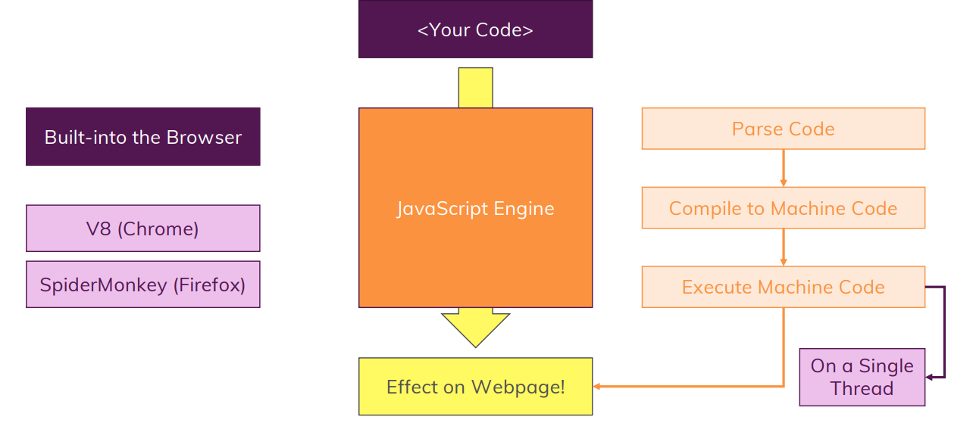
How JavaScript code Executes

Slide 4
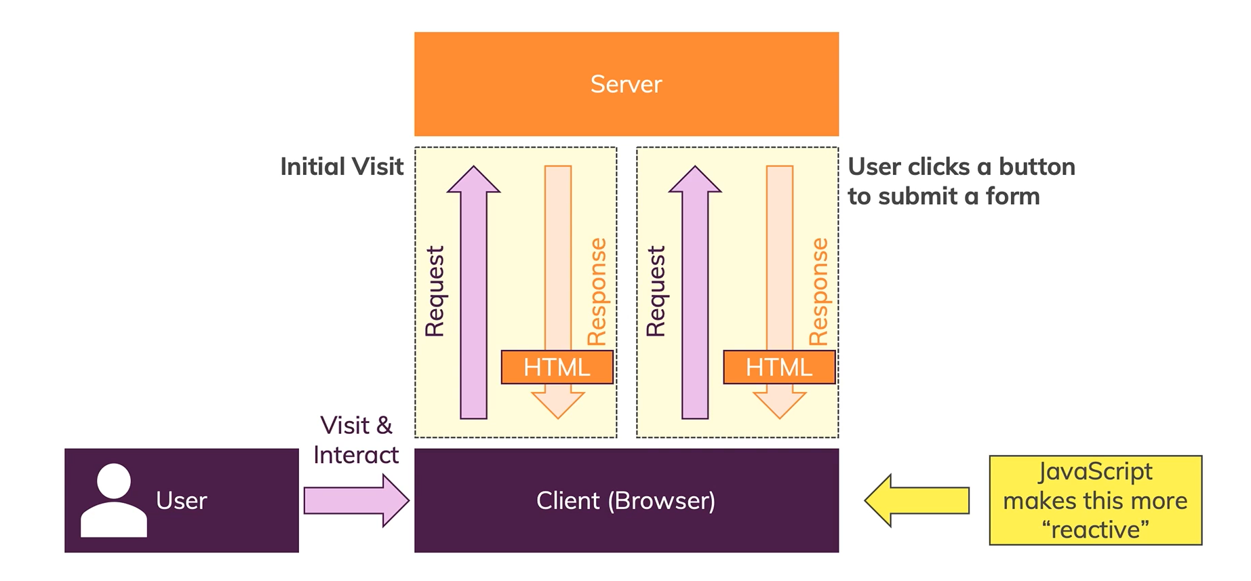
How do Webpages Work

Slide 5
Dynamic interpreted, Weakly Typed
Dynamic
JavaScript is not pre-compiled , its compiled at runtime and the code can change at runtime.
Weakly-Typed
Data types are assumed automatically
You don’t have to define that a variable has to hold a specific data type.
Data type can change

Slide 6
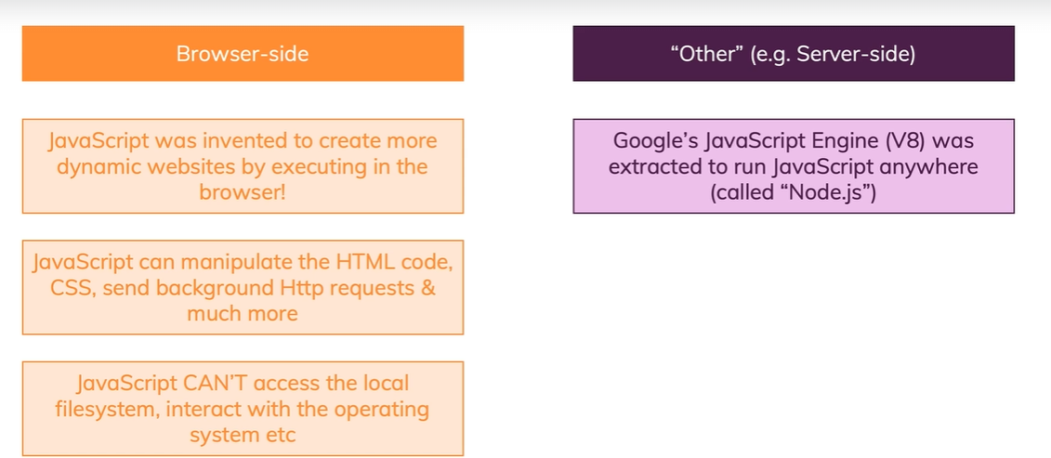
JavaScript Runs on a Hosted Environment
NodeJS is used for Server-side
NodeJs Can also access file system

Slide 7

What is ECMAScript
It was created to standardize JavaScript
Browsers use ECMAScript to interpret JavaScript code
ECMAScript provides the rules ,details and guidelines that a scripting language must contain to be considered part of ECMAScript

Slide 8
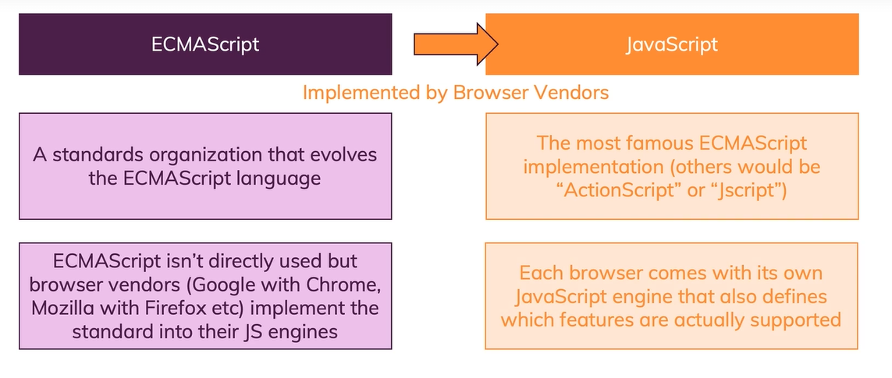
ECMAScript Vs JavaScript
ECMAScript/JavaScript are Always Evolving

Slide 9

JavaScript Framework
ReactJS, Angular and VueJS among others are Frontend Frameworks designed to be used with web applications and interactive websites
1
NodeJS – a platform built on JavaScript .Used to run advanced operation and applications on servers such as querying a database ,authenticate users and others.
2
NPM is a JavaScript Package manager with a lot of Open source Projects and Libraries.(part of Node)
3

Slide 10

The Console
We can use console to :
Debugging
Test code
Practice code

Slide 11
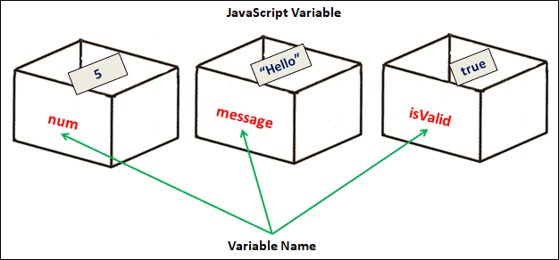
Variables
What is a Variable
Data in a computer is stored in memory For example a value of Josh is stored in memory address of 0009aa884b(This is a long, complicated number) so instead we use a variable called name to represent the memory address.
JavaScript variables are storage for data, where programs can store value. Basically, It’s an area of memory where JavaScript stores the data.
We usually assign a name to the memory. The programs can then use the variable name to identify the memory location. It makes the coding easier.

Slide 12
Declaring Variables
We need to create the variables before using them. In JavaScript, we call it declaring the variable. There are three keywords using which we can declare a variable.
They are :
var
let
const
To declare a variable we use the keyword followed by name of the variable that we want to declare.

Slide 13
Let
You can only override the value but not redeclare..

Slide 14
Const Keyword
With const when declaring you have to give an initial value and that value cannot be reassigned or redeclared.

Slide 15
Var
Disadvantage :
Hoisting
Uses function scope not block scope
Allows redeclaration

Slide 16
Initializing a variable
Initializing a variable means storing an initial value in it before using the variable. To store data, we need to make use of the assignment operator. The assignment operator represented by the symbol equals sign (=) is one of the several JavaScript Operators. We use it to assign a new value to a variable.

Slide 17
Identifiers
The identifier name must be unique within the scope.
The first letter of an identifier should be a
upper case letter
Lower case letter
underscore
dollar sign
The subsequent letters of an identifier can have
upper case letter
Lower case letter
underscore
dollar sign
numeric digit
We cannot use reserved keywords.
They are case-sensitive. For Example, sayHello is different from SayHello
Cannot use spaces in a identifier name.
Avoid using the JavaScript Reserved Keywords as identifier name

Slide 18
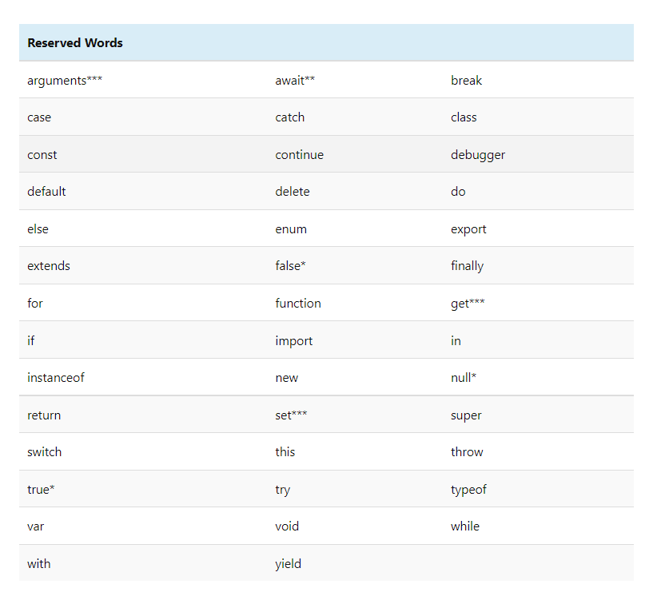

Slide 19
Comments
The JavaScript allows us to add single line comments or Multi line comments
Single-line comments ( // ) − Any text between a // and the end of a line is treated as a comment.
Multi-line comments (/* */) − These comments may span multiple lines.

Slide 20
Data Type
JavaScript has two types of values: primitive values and reference values.
You can add, change, or delete properties to a reference value, whereas you cannot do it with a primitive value.
Copying a primitive value from one variable to another creates a separate value copy. It means that changing the value in one variable does not affect the other.
Copying a reference from one variable to another creates a reference so that two variables refer to the same object. This means that changing the object via one variable reflects in another variable.

Slide 21
Primitive values
Number
String
boolean
Null
Undefined
Symbol

Slide 22
Reference values
Object

